Slide 1
User Auditing
week of 10/5/2020

Slide 2

Users? They exist? no way
Users: people that exist on the system and can use varying features of the system
standard: users that have normal privileges
User ID >= 1000
administrator: users that have elevated privileges
UID = 0
system/service: “users” that run services
UID = btwn. 0 & 1000
Today, we’re going to learn how about users, groups, and much more! :))
Notes:
https://create.kahoot.it/v2/details/b0d59909-d459-4d41-950a-21c9f3eb8d56

Slide 3

Adding/Deleting Users
adduser [user_name]
adds a user to the system (where?)
prompts for password & personal information
creates corresponding group named [user_name]
deluser [user_name]
deletes an existing user from the system
must have sudo privileges (standard user can’t make accounts)
useradd, userdel (same thing but more bare bones)
Notes:
we’ll get into groups later but just mention it offhand
other stuff: name, home address, phone number, etc. (GECOS) → connect to /etc/passwd field
explain how useradd and userdel are just outdated versions of the better counterparts

Slide 4
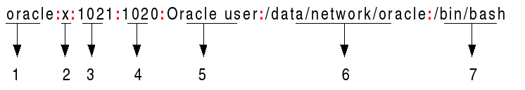
/etc/passwd file (not password)
file that contains information about all users (admin, standard, system)
How do we get here? (to read/write the file)
If you have permissions to write on this file, you can edit the lines directly and configure users

Slide 5
/etc/passwd in detail
sorry guys no polaroids :(
Name of user
Encrypted Password
User ID (UID)
Group ID (GID)
GECOS/Comments (Extra Info)
Home directory (absolute path)
Shell directory
make sure users have functioning shells (/bin/bash)
Remember the difference between shell and terminal?
Notes:
Use this time to review shells (can they differentiate between shell and terminal)

Slide 6
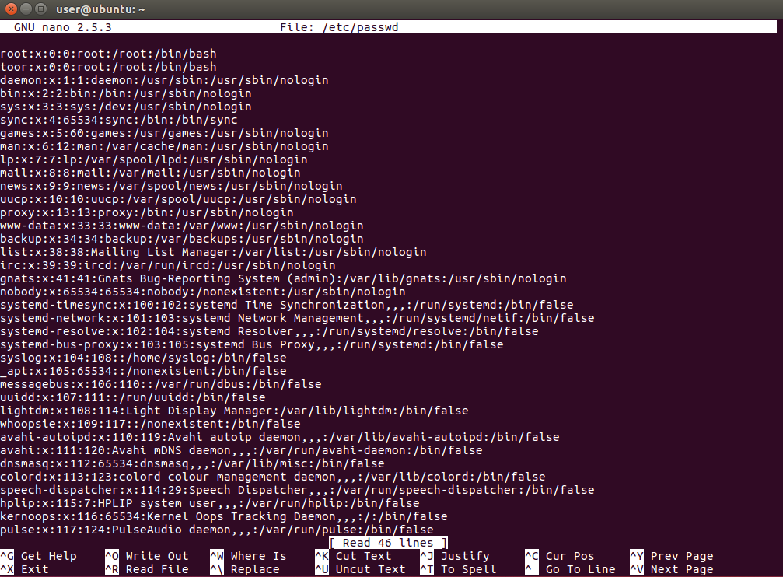
Notice anything
different between this picture and your own file?

Slide 7
What is the UID for that different line?
Why is that a security issue that must be resolved?

Slide 8
/etc/shadow
file that contains all the passwords of all users (x in the /etc/passwd file)
sudo nano /etc/shadow
passwords are hashed (encrypted for security)
$1: MD5
$5: SHA-256
$6: SHA-512 (most secure)
don’t worry too much about the hash types, just be aware of them

Slide 9
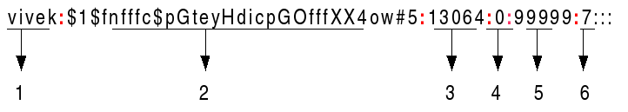
/etc/shadow in detail
Name of User
Encrypted Password (! and * what is this)
Last Password Change
Minimum Password Age
Max Password Age
Warning Period (days)
Notes:
! → no password present (security issue)
*: no password as well but most likely applies to system users

Slide 10
Guest Account
Guest account: standard account that can be used temporarily (does not require password)
Is this secure?
What should we do about that?
Guest account config is located in:
/etc/lightdm/lightdm.conf
/usr/lightdm/lightdm.conf
It may vary based on version (so research!) but we’ll go
over proper configuration next!

Slide 11
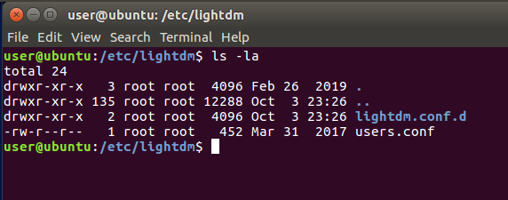
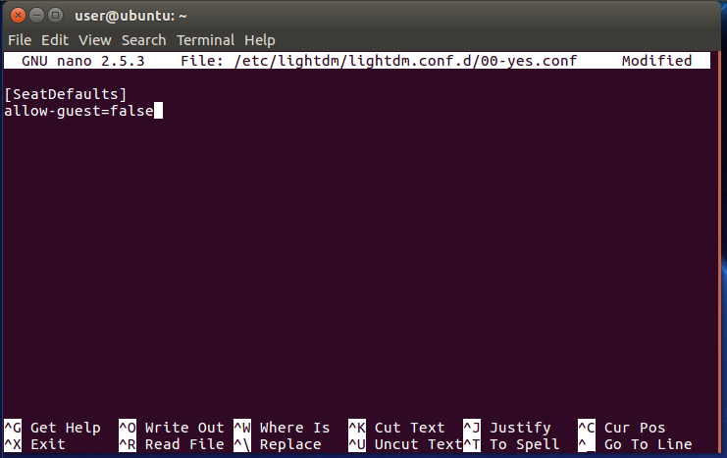
Picture of /etc/lightdm/

Slide 12
/etc/lightdm/lightdm.conf
allow-guest=false
essentially disables the guest account (logical if you read it)
autologin-user=[username]
self-explanatory
could be a security issue but really a preference

Slide 13




What do these commands look like?
Let’s check it out in VirtualBox wooooOOOoO practice
“boy oh boy
VirtualBox”
- Ryan Nguyen 2020
Notes:
Ok very cool quote
thank you

Slide 14

Groups
Groups: multiple users that are organized based on certain file permissions on the system
ex. engineering, IT, marketing (real-life business application)
In a Linux system, there are groups that also have certain permissions for files
root, sudo, admin, etc.

Slide 15
Commands for Groups
addgroup [group_name]
creates a new group w/ [group_name]
delgroup [group_name]
deletes an existing group
gpasswd -a [user_name] [group_name]
adds a user to the specified group
also adduser [user_name] [group_name]
-d: deletes a users from the group
-A: sets a user as group admin
groupadd and groupdel outdated versions of the respective commands above

Slide 16
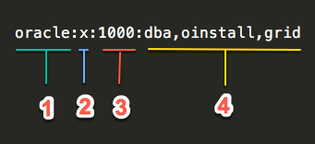
/etc/group file
file that contains all information about groups and the users within them
just like /etc/passwd file, with the right perms, you can add/remove groups and their members manually
name of group
Encrypted Password
GID
Members ofGroup
Notes:
group passwords are useless lol

Slide 17
